Slide 1

Datapath

Slide 2
Introduction
Movement of data within a processor from one component to another
Registers, ALU, and the interconnecting bus collectively form the datapath
ALU
Performs arithmetic and logical operations
Contains control lines to select one of the possible ALU operations
Registers
General purpose registers to store data, memory address register (MAR), memory data register (MDR), program counter (PC), instruction register (IR), temporary registers (optional)
Buses
Internal (one or more) and external to carry the data from one component to another

Slide 3
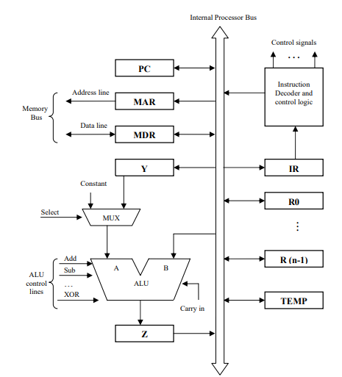
Single Bus Organization of Datapath

Slide 4
Basic Steps in Instruction Execution
Fetch the contents of the memory location pointed to by the PC. Load these contents into the IR to be interpreted.
IR ← [PC]
Assuming that the memory is byte addressable, increment the contents of the PC by 4.
PC ← PC + 4
Carry out the actions specified by the instruction.

Slide 5
Basic Steps in Instruction Execution
Most instructions involve the following operations:
Transfer a word of data from one processor register to another or the ALU
Perform an arithmetic or logical operation and store the result in a processor register
Fetch the contents of a memory location and load them into a processor register
Store a word of data from a processor register into a memory location

Slide 6
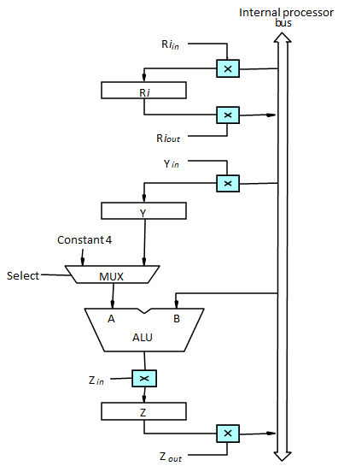
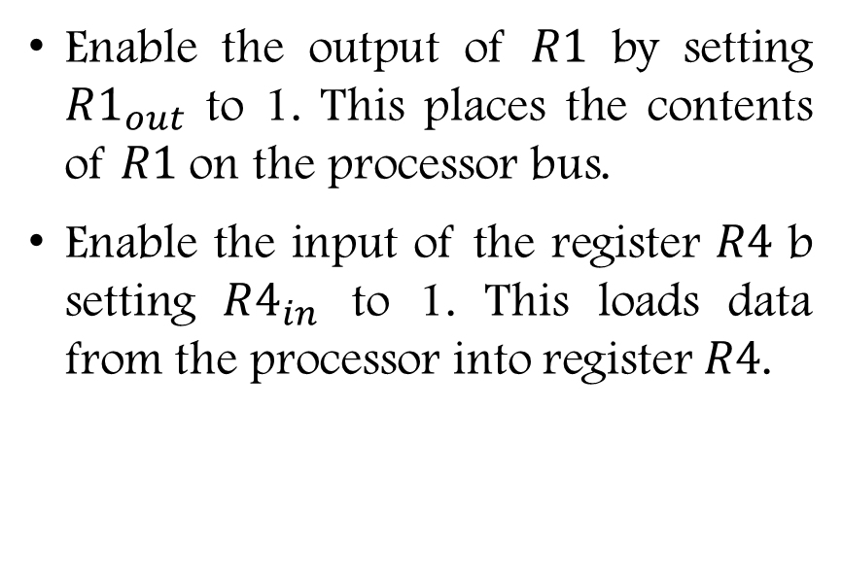
Register Transfer
MOV R1, R4
Enable the output of $R1$ by setting $R1_{out}$ to 1. This places the contents of $R1$ on the processor bus.
Enable the input of the register $R4$ b setting $R4_{in}$ to 1. This loads data from the processor into register $R4$.

Slide 7

Arithmetic and Logic Operations
ADD R1, R2, R3
$R1_{out}$, $Y_{in}$
$R2_{out}$, $SelectY$, $Add$, $Z_{in}$
$Z_{out}$, $R3_{in}$

Slide 8
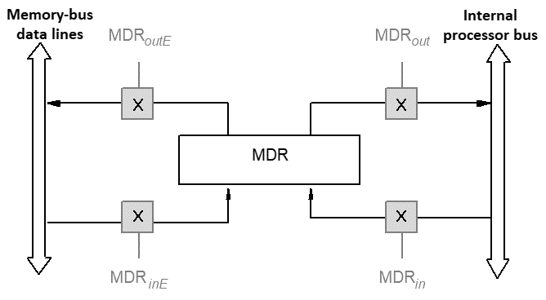
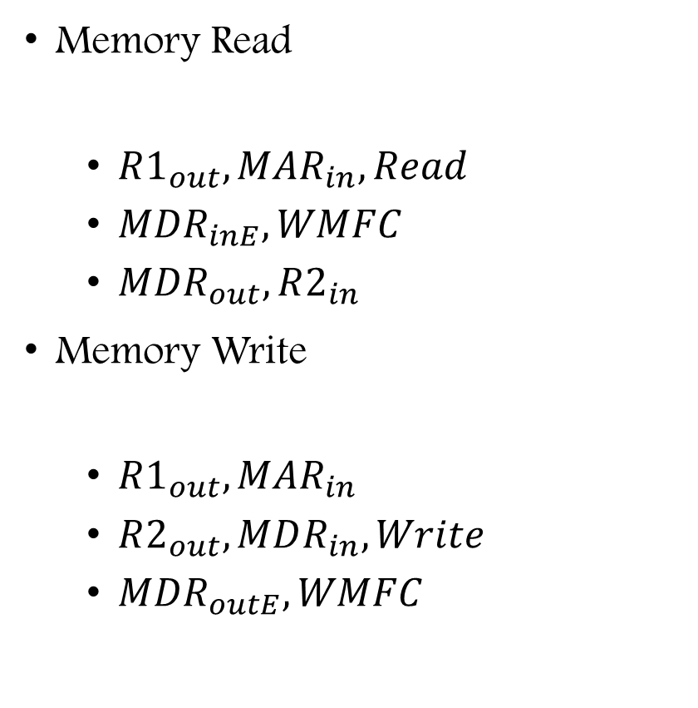
Memory Read and Write
Memory Read
$R1_{out}, MAR_{in}, Read$
$MDR_{inE}, WMFC$
$MDR_{out}, R2_{in}$
Memory Write
$R1_{out}, MAR_{in}$
$R2_{out}, MDR_{in}, Write$
$MDR_{outE}, WMFC$
MOV (R1), R2
MOV R2, (R1)

Slide 9
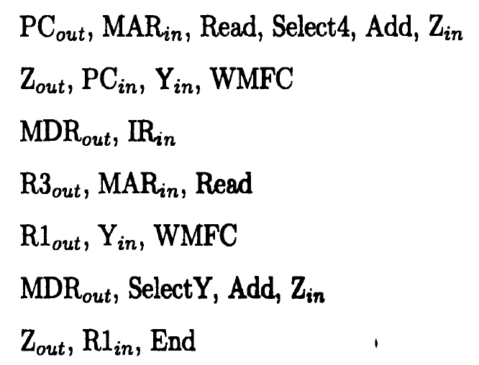
Execution of a Complete Instruction
ADD (R3), R1

Slide 10
Multi Cycle Data Path Architecture

Slide 11
Why Multi Cycle Data Path ?
In a single cycle data path architecture , exclusively single data word could be moved through the bus in a given clock cycle
Because of this no of steps needed to execute the inst increases
To decrease the no of steps needed to execute the inst and to transfer more than one word in a clock cycle we go for multicycle

Slide 12
How Multi Cycle Data Path Works
Three buses are used to link reg and ALU of the CPU
All GPR ,
R₁, R₂…R_{n} are presented in one block known as reg files
Figure 2. shows the register files has three ports

Slide 13
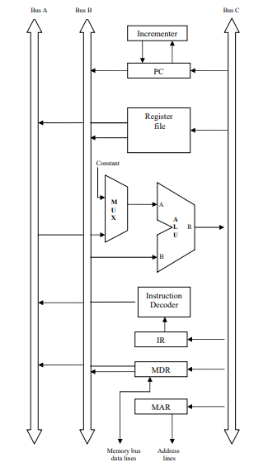
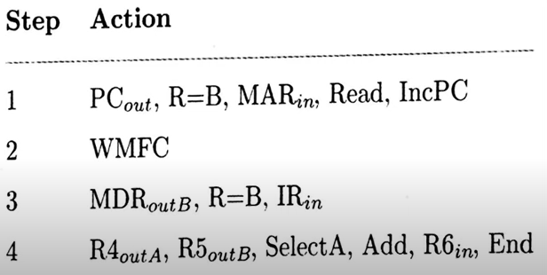
Multi Cycle Data Path Architecture Add R₆, R₄, R₅

Slide 14
How Multi Cycle Data Path Works
One input and two output ports
Therefore data of three registers are possible to access in single clk cycle
Through Bus C, the value could be put in one reg
Data from two regs is available through Bus A and Bus B

Slide 15
How Multi Cycle Data Path Works
Bus A and B are used to move the source operands to i/ps of the ALU A and B
After ALU process is executed the resultant is moved to destination operand through the bus C
Separate incremental unit is provided to increment the value of PC after every instruction is executed

Slide 16
Execution of Instruction using Multi Cycle Data Path Add R₆, R₄, R₅ Control Sequence
The inst adds the values of register R₄ & R₅ and stores the resultant in R₁

Slide 17
Multi Cycle Data Path Add R₁, R₂, R₃ Control Sequence Explanation
Step 1: The value of the PC are moved to MAR by means of Bus B to begin Read operation. PC→MAR
Parallelly PC is incremented point towards the next instruction PC→PC+1

Slide 18
Multi Cycle Data Path Add R₁, R₂, R₃ Control Sequence Explanation
Step 2: The processor waits for WMFC signal from the memory
Step 3: The inst code is moved from MDR to IR MDR→ IR
Step 4: The inst decoder decodes the IR contents

Slide 19
Multi Cycle Data Path Add R₆, R₄, R₅ Control Sequence Explanation
Step 4: Two values from reg R₄ & R₅ are made accessible at inputs A and B of ALU by means of Bus A & B
By activating the Add signal two inputs are added
Through Bus C the resultant is stored in R1

